Slide 1
CIS041-3 Advanced Information Technology
Week 1
Introduction
Gangmin Li
(Office hours: 13:00-17:00 every Friday)

Slide 2
Today’s schedule
Unit Overview
Learning outcomes
Tentative syllabus
Teaching methods
Timetable
Assessments
Requirements for students

Slide 3
Unit overview

Slide 4
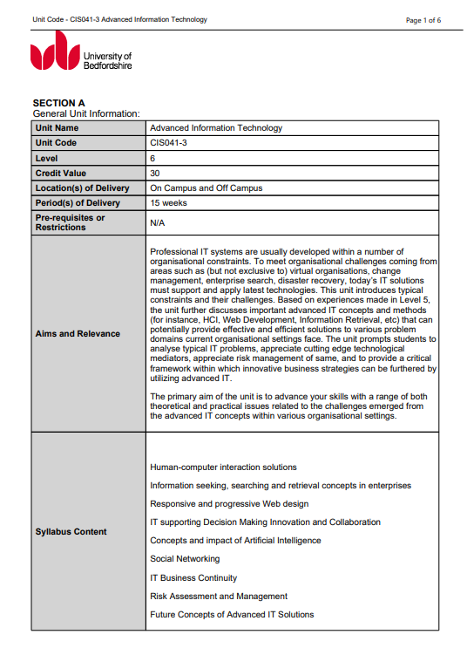
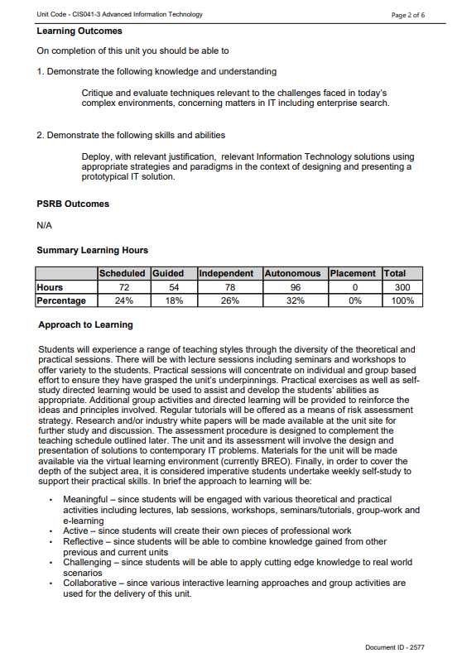
UIF_2577

Slide 5
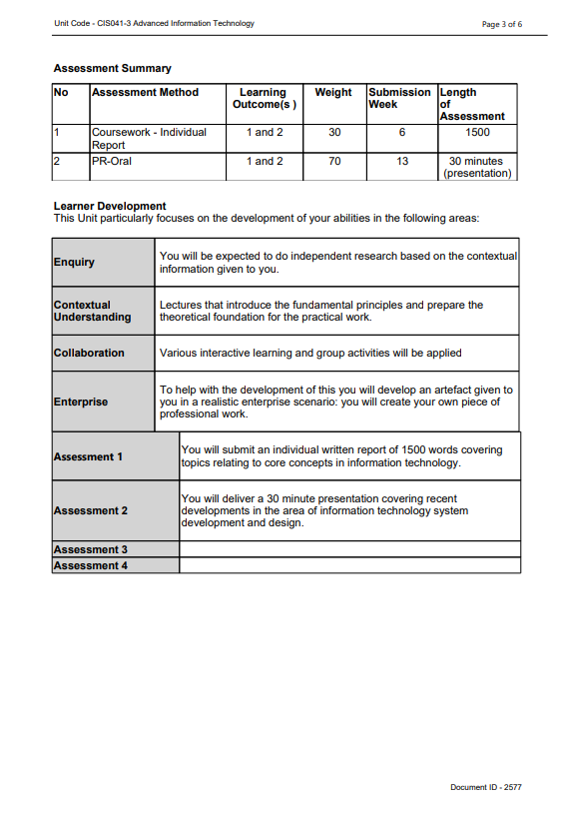
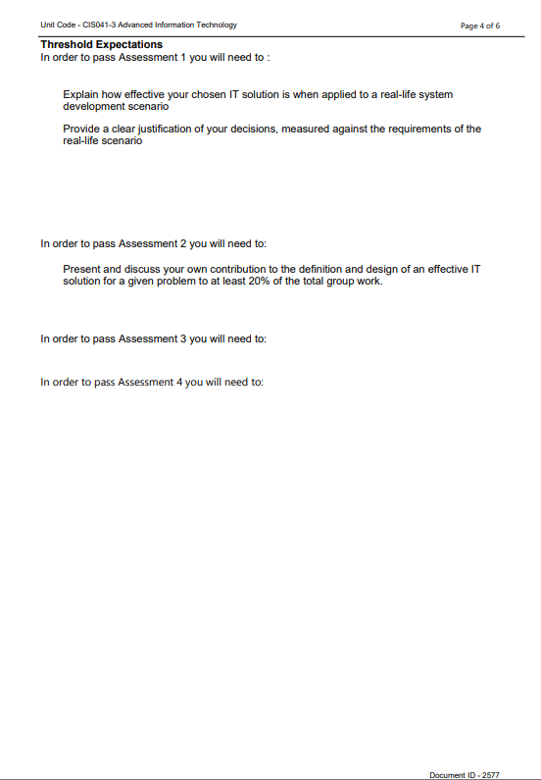
UIF_2577

Slide 6
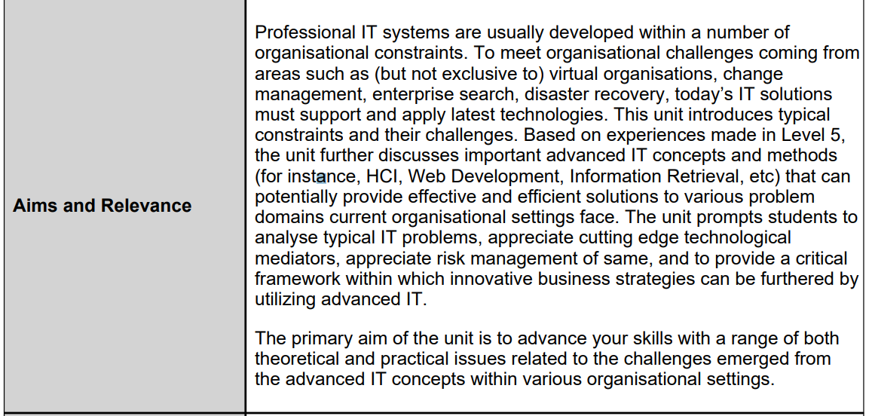
The purpose of the unit

Slide 7
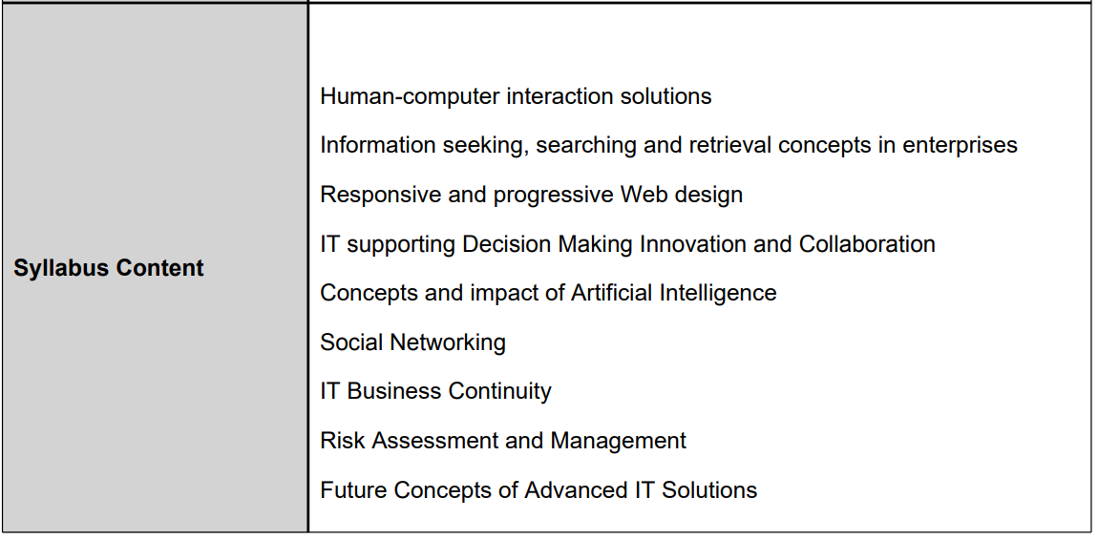
Syllabus

Slide 8
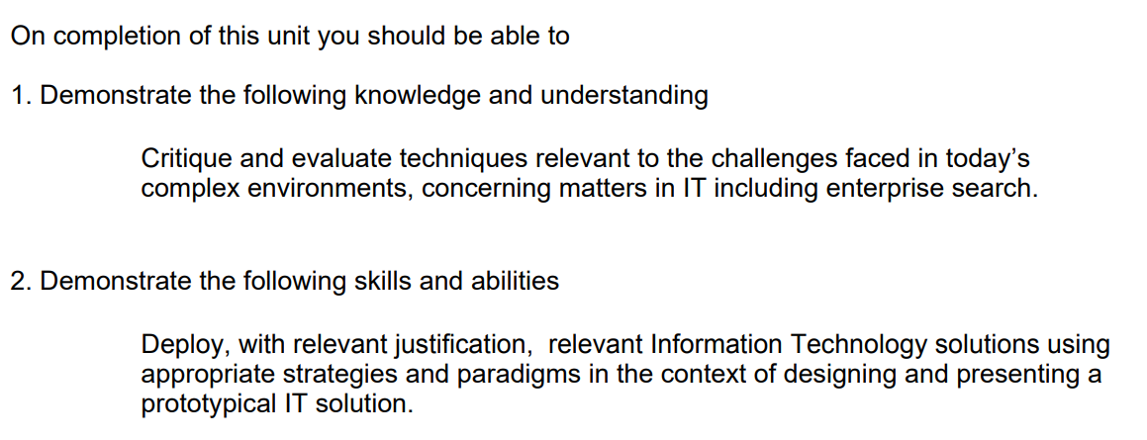
Learning Outcomes

Slide 9
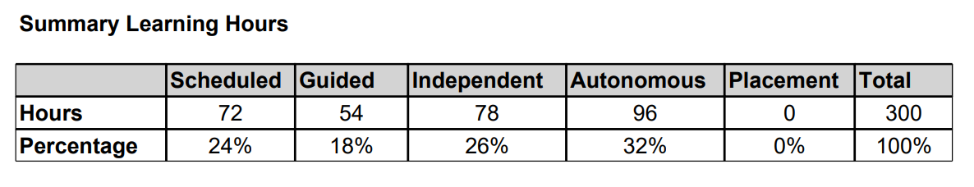
Summary Learning Hours
24% lectures
18% (discussions, tutorials, seminars)
Independent study 26%
Autonomous 32%
58% 174 hours from you!!!!

Slide 10
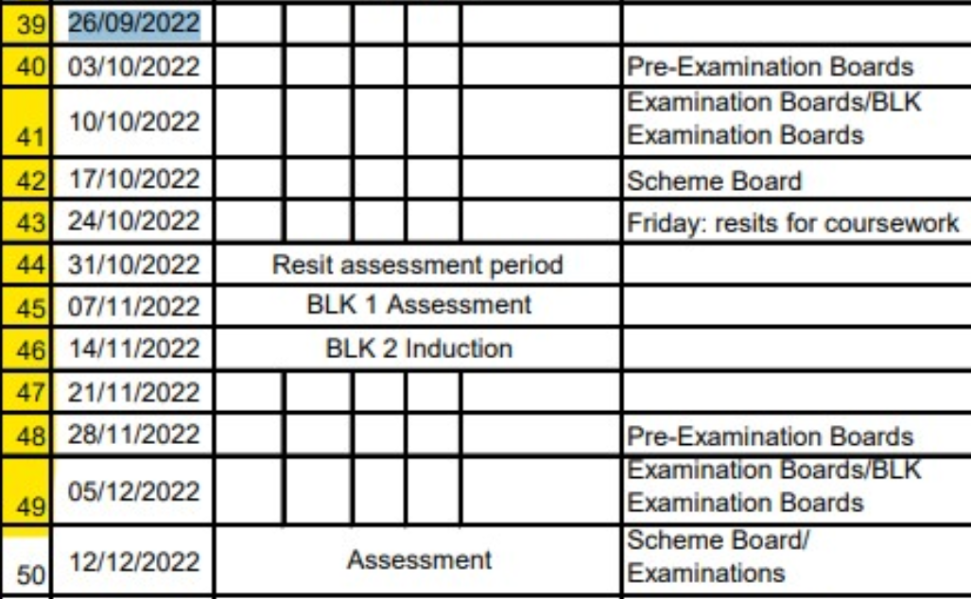
Study Schedule
Wk
1
2
3
4
5
6
7
8
9
10
11

Slide 11
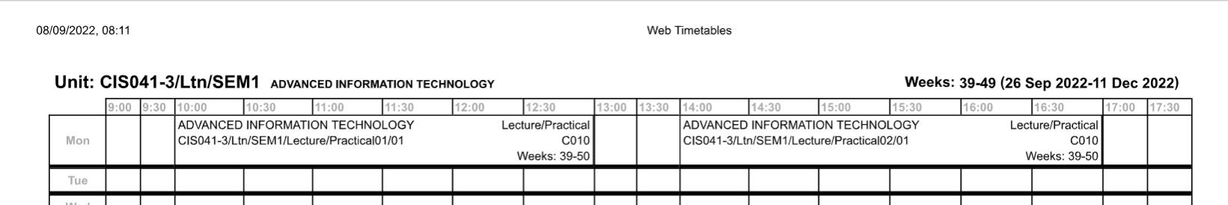
5 hours a day!

Slide 12
Self-directed Study
A vast amount of your time will be self-directed studies (174 hrs)
Besides lecture notes, you should also consider external sources
YouTube videos
Google Scholar (http://scholar.google.com/)
Search engines (Google, Bing, …)
Research Management Tools (e.g., Mendeley http://www.mendeley.com/)
https://stackoverflow.com/

Slide 13
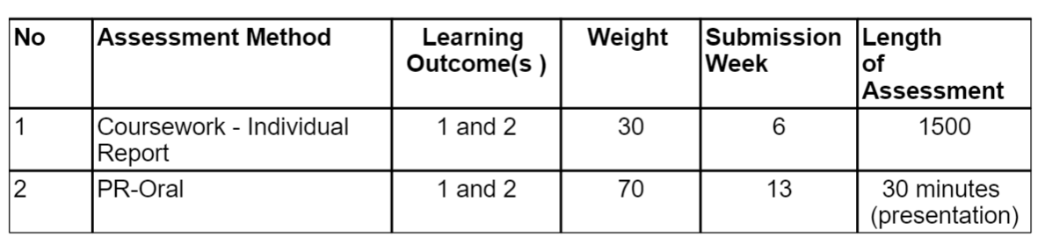
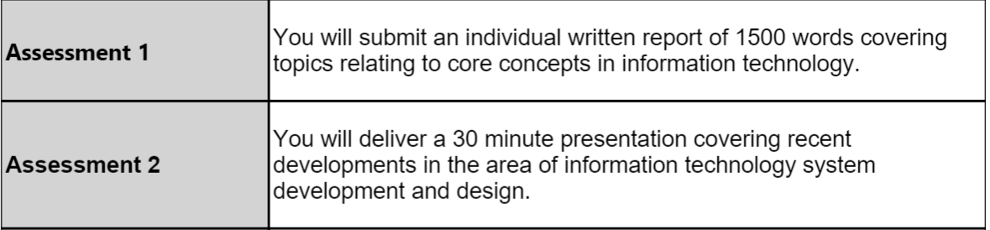
Assessments
11

Slide 14
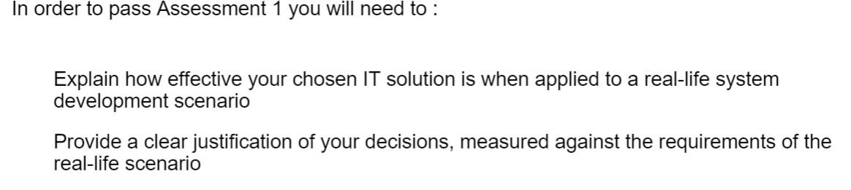
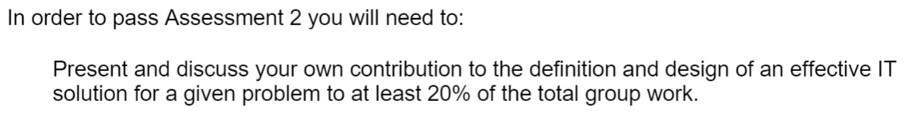
Threshold Expectations for the assessment

Slide 15
Text
https://rl.talis.com/3/bedfordshire/lists/D384ECF1-3FB5-E17B-F05B-3497E8D08FC1.html?lang=en-GB

